Slide 1
CO 2
Session no. 16

Slide 2
TRANSITION FROM IPv4 TO IPv6
Because of the huge number of systems on the Internet, the transition from IPv4 to IPv6 cannot happen suddenly.. It takes a considerable amount of time before every system in the Internet can move from IPv4 to IPv6.. The transition must be smooth to prevent any problems between IPv4 and IPv6 systems.
Topics discussed in this section:
Dual Stack
Tunneling
Header Translation

Slide 3
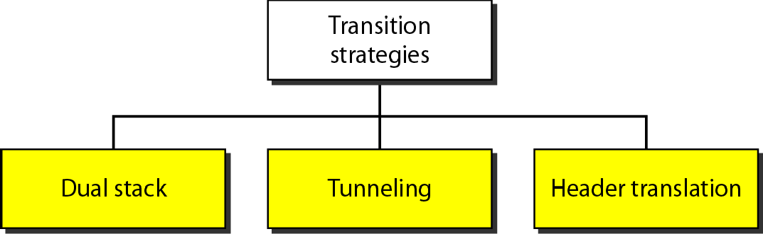
Three transition strategies

Slide 4
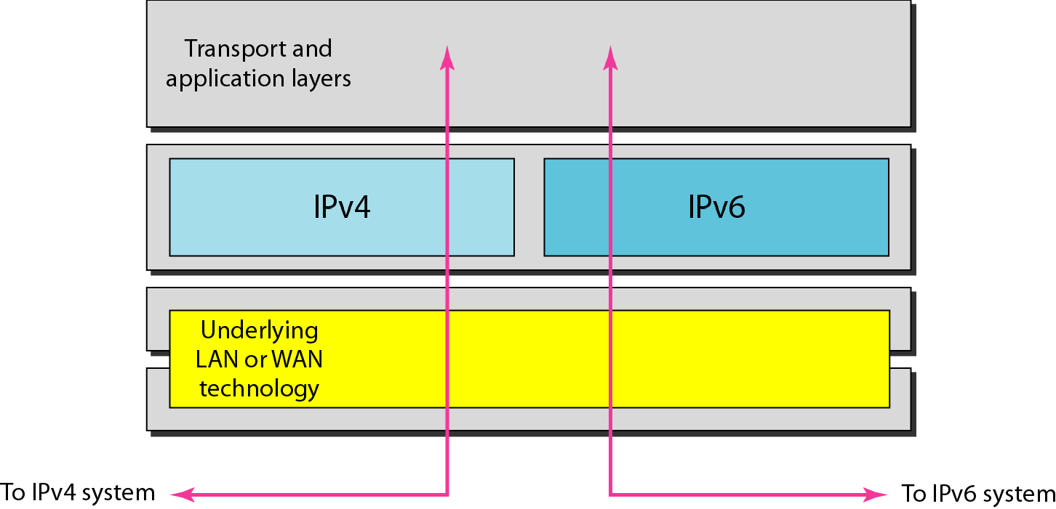
Dual stack

Slide 5
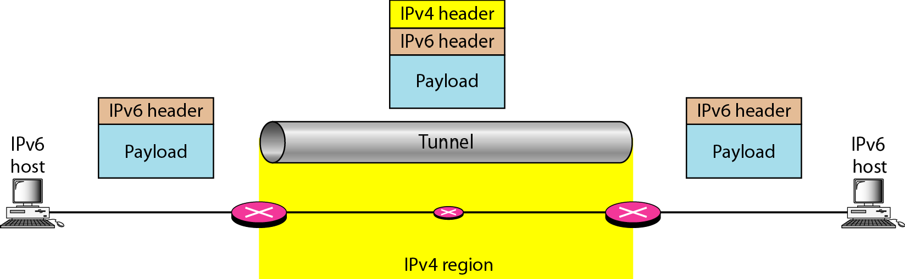
Tunneling strategy

Slide 6
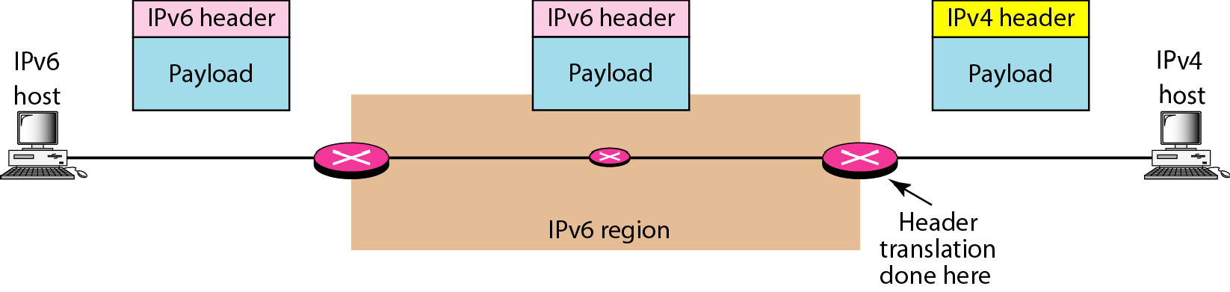
Header translation strategy

Slide 7
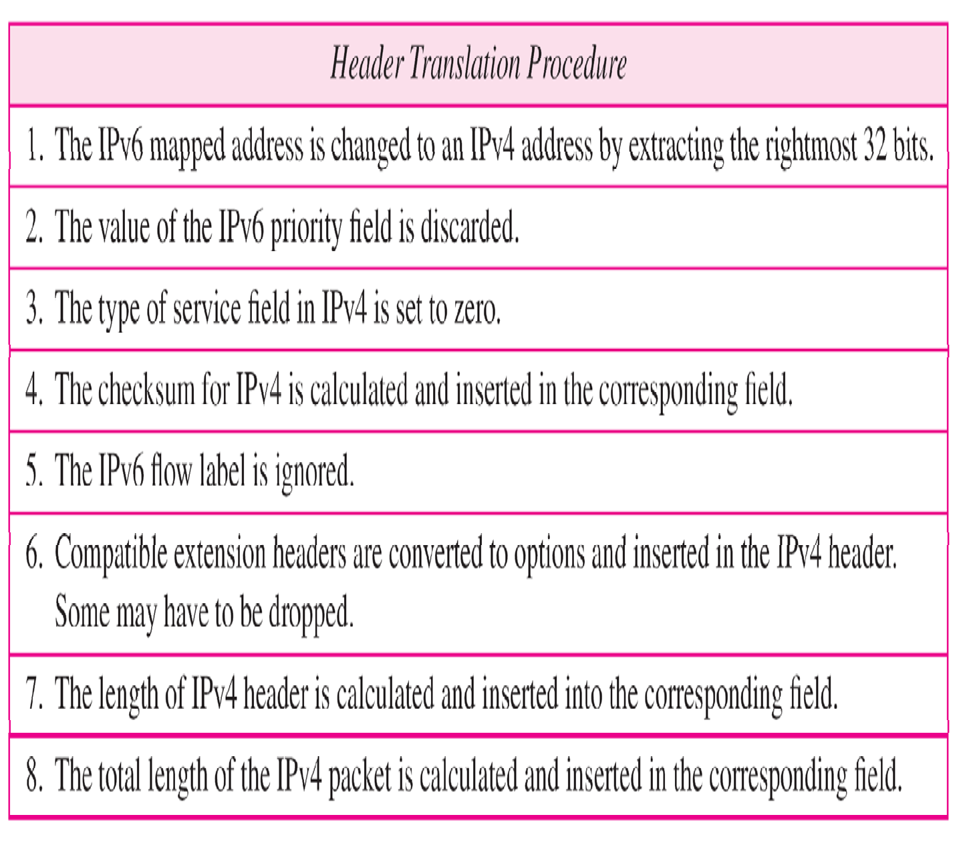
Header translation procedure

